Slide 1

MINOR PROJECT
Alerting System for
Mine Workers
made by
Ananya Sharma 03113502812
Reetika Anand 06613502812

Slide 2
Safety in mines-a glance
Listed as the most dangerous industry for workers until a decade ago, mining is now outranked by industrial fishing, roofing and aircraft-related occupations, among others, according to the U.S. Bureau of Labour Statistics.
Miners' chances of dying from explosions, cave-ins and equipment accident are ever-present, and many chronic and fatal conditions are linked to their toxic work conditions.
According to the MSHA (Mine Safety and Health Administration), biggest health dangers include exposure to:
Methane
Low oxygen levels
Dust
Radon
Welding fume
Mercury
Noise
Heavy loads

Slide 3
The Next Step...
Modern coal mines have rigorous safety procedures, health and safety standards and worker education and training, which have led to significant improvements in safety levels in both underground and opencast mining. We aim to take these safety measures one step forward.
TRADITIONAL METHODS:
In traditional method the abnormality in any of the parameters are transmitted in wireless communication to intimate the status to monitoring section and in this method no alert in the form of voice is given to the workers inside the mine. Hence we go for proposed system.

Slide 4
What do we aim to do?
To increase both safety and productivity in mines, a reliable communication must be established between workers, moving in the mine, and a fixed base station. Inside mines, the wired communication system is not so effective, because of wires can be damaged inside mines.
In this system, the basic parameters like temperature, humidity and hazardous methane gas are going to be monitored and if any abnormality happen in any of the parameters means it will be intimated in the form of voice within the mine and transmitted to the monitoring section via RF communication module. For that we are having system with Microcontroller, in that the sensors are interfaced with it. Here a voice IC named APR9600 is used for intimating the abnormal status in voice format

Slide 5
Why this solution?
Inside mines, the wired communication system is not so effective.
Inside mines due to uncomfortable situation the installation cost as well as maintenance cost is high for wired communication networks.
To maintain the continuity of the communication system is very much important to know the actual position and condition of the trapped workers.
To increase both safety and productivity in mines.

Slide 6
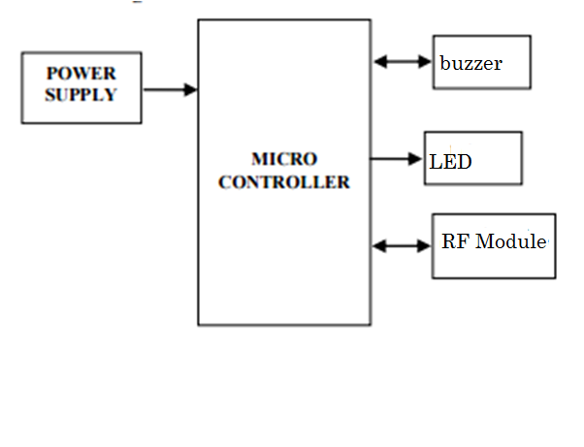
How this will be accomplished?
Monitoring/ ground unit

Slide 7
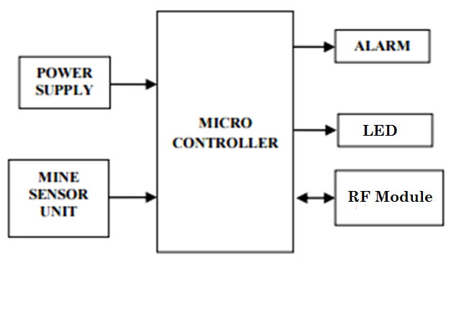
Mining/ underground unit

Slide 8
Working-
This project consists of two sections.
Mine section
Monitor section
In the mine section we have mine sensor unit, APR9600, RF 434MHz module.
Mine sensor unit is used to detect any anomalies in the temperature, smoke content in the air occurring in the mine working place and sends signal to microcontroller. Whenever microcontroller receives signal from this unit, it sends to monitor section PC through rf module and that message will display on LCD screen and also message will be announced on the speaker for uneducated people. The buzzer will give indication sound to them.
The monitor section contains PC and rf module. The rf module is connected to serial port of the pc. In pc the hyper terminal provides necessary communication between mine section to monitor section. By using hyper terminal we get updated information about transmitter working conditions and also sends some announcement to the workers through rf module.

Slide 9
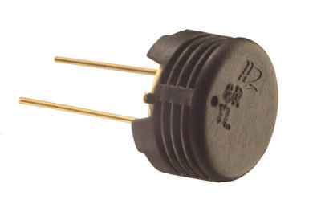
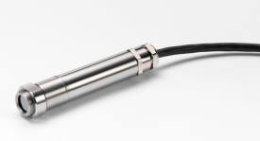
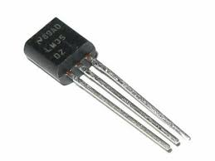
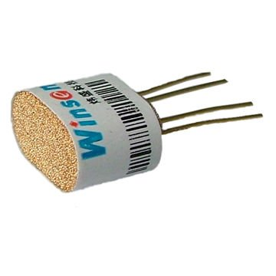
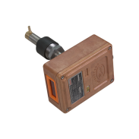
Components-
Sensor Unit:
Humidity Sensors
Temperature Sensors
Gas Sensors

Slide 10
RF 434MHZ
An RF module (radio frequency module) is a (usually) small electronic device used to transmit and/or receive radio signals between two devices. In an embedded system it is often desirable to communicate with another device wirelessly. This wireless communication may be accomplished through optical communication or through radio frequency (RF) communication. For many applications the medium of choice is RF since it does not require line of sight. RF communications incorporate a transmitter and/or receiver.
In this project, RF modules are used to transfer signals from one station to another establishing a wireless communication system between the same. It has 100m range.

Slide 11
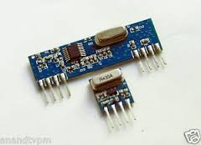
I

Slide 12
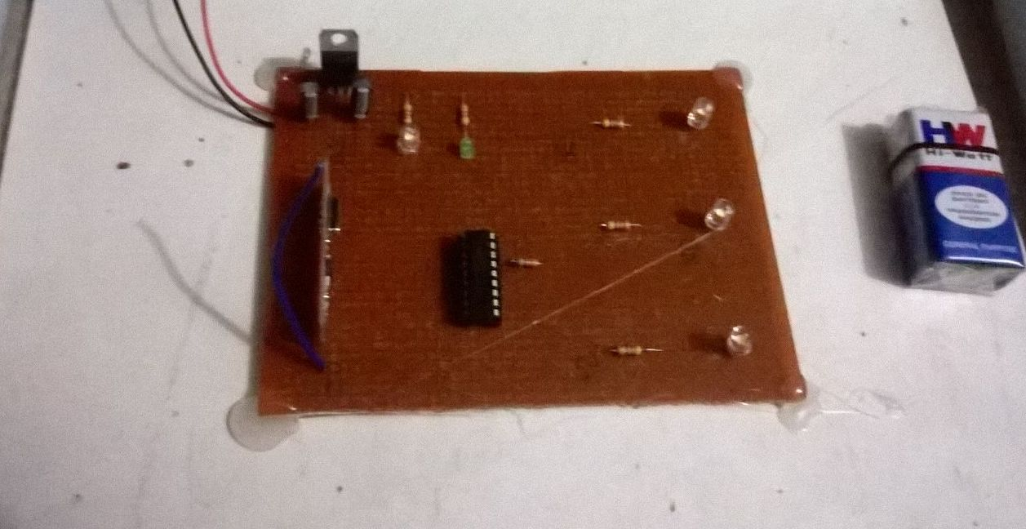

Slide 13
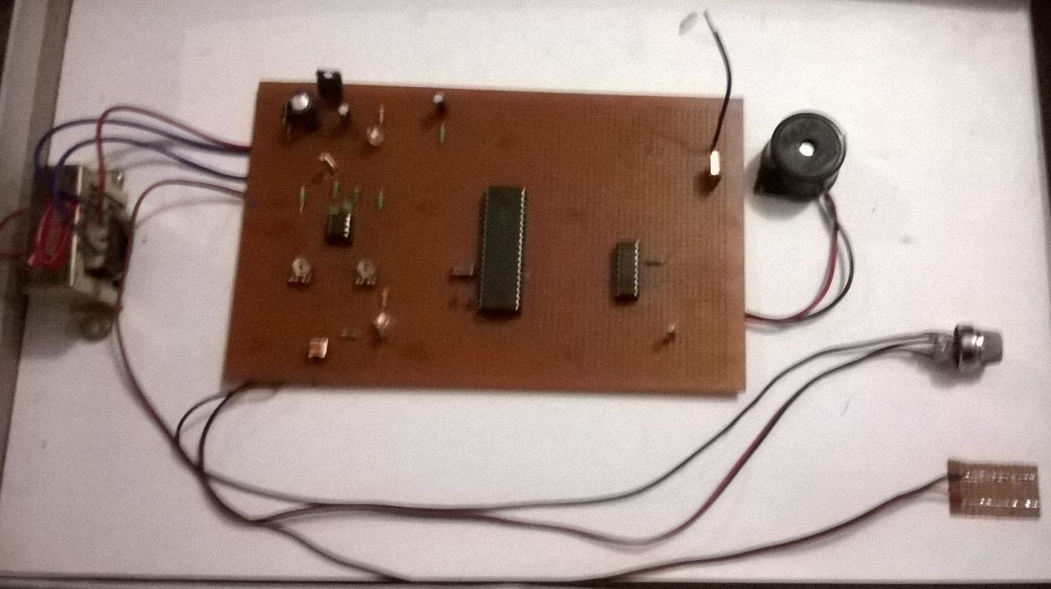

Slide 14
.WHY rf 434 MHz?
wireless rf-434 MHz systems that specialize in long range and low data throughput can be very cost effective while providing the following benefits to an rf-434 MHz system:
Ease of use and deployment in new and legacy systems
Extended range capabilities
Portability
Ease and flexibility of installation
Ease with which original equipment manufacturers (OEMs) are able to extend their product lines by adding wireless capabilities to new and existing products

Slide 15
Future Work-
In the future we aim to extend the project to include more parameters like monitoring the oxygen levels in the mines.
We can use location tracking of the workers in order to create ease in rescue operations in case of a mishappening.

